Slide 1
Moving Students Between Sessions
For Computer-Based Testing
Notes:
Welcome to the Moving Students Between Sessions training module.
This training module gives the steps to move students from one session to another for computer-based testing. This module is not applicable to paper-based testing.

Slide 2
Glossary
PearsonAccess^{next} (PAN): The online management system used to register students, update student test settings, and manage activities for computer-based testing.
PAN Session: A group of students in PearsonAccess^{next} who will be testing at the same time. (This is different from the actual “test session.”)
Notes:
Please take a moment to pause the module so that you can read the definitions of the different components of the process for moving students between sessions.

Slide 3
Moving Students
  Correcting an error in the PearsonAccess Next Session the student was initially assigned to
  Updating a student’s PearsonAccess Next Session
  (Optional) Moving a student who was absent for a test session to be in a new PearsonAccess Next Session for make-up testing
Notes:
The most common reasons to move a student from one PearsonAccess^{next} Session to another include the following:
Correcting an error in the PearsonAccess^{next} Session the student was initially assigned to
Updating a student’s PearsonAccess^{next} Session
(Optional) Moving a student who was absent for a test session to be in a new PearsonAccess^{next} Session for make-up testing

Slide 4
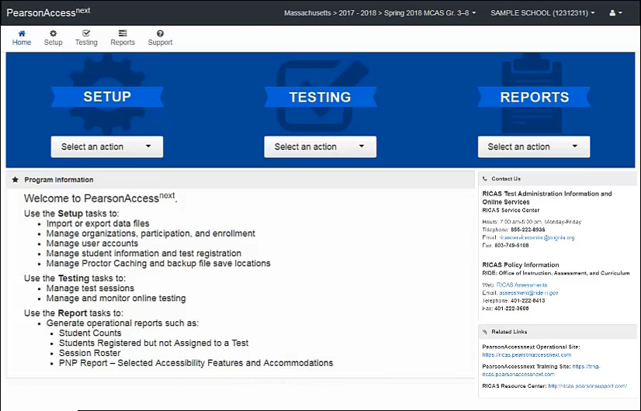
How to Move Students
Notes:
In order to move a student to a new PearsonAccess^{next} Session, the test assigned to the Session must match the test assigned to the student.
To move a student into a Session that has already been created, first navigate to Testing > Sessions and check the boxes next to the current Session as well as the session in which the student will be moved. Then go to Testing > Students in Sessions. Click the current Session on the left-hand side of the screen, scroll down, and check the box next to the student(s).
Click Select Tasks, then check Move Students between Sessions, and then click Start.
On this page, check the box under the name of the new PearsonAccess^{next} Session, then click Move.
To move a student into a new Session in PearsonAccess^{next}, first you will need to create a new Session by clicking the button for Create Session, which is also on this page. Then fill out the details for the new Session, and then click Create. You will then see the new Session listed on this page and can check the box under the Session name to move the student.

Slide 5
Resources
PearsonAccess^{next} User Guide – Move Students Between Online Test Sessions
Notes:
You may use this resource to help with the process when you do it yourself.

Slide 6
Thank you.
Notes:
This concludes the Moving Students Between Sessions training module. Thank you.

