Slide 1
PearsonAccess Next Dashboards
Rhode Island Comprehensive Assessment System (RICAS)
Notes:
These training slides give an overview of the Dashboards feature in PearsonAccess Next.

Slide 2
Topics
Dashboard Introduction
Dashboard Roles
Accessing the Dashboards
Dashboard Home page
Dashboard User Settings
Notes:
We will cover the topics listed on this slide.

Slide 3
Dashboard Introduction
PAN Dashboards provide a visual display of information available elsewhere in PearsonAccess Next (PAN).
When logging in, a Dashboard icon will be available at the top of the main menu bar on the left.
A Dashboard icon will also be available on the top menu bar on all pages in PAN for users with the permissions described on the next slide.

Slide 4
Dashboard Roles
The following PAN user roles have dashboard access:
District Test Coordinator
School Test Coordinator
Technology Coordinator
Users should be sure they have selected the correct administration in the upper right-hand corner.
For users with access to multiple organizations in PAN, be sure you have also selected the correct organization in the upper right-hand corner.

Slide 5
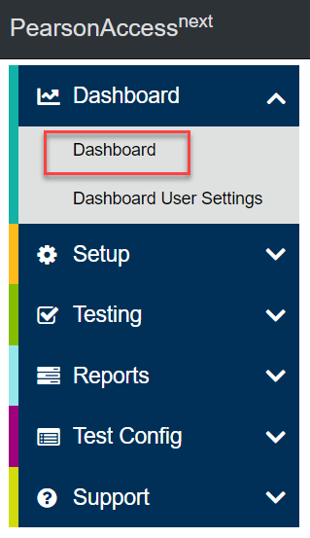
Accessing the Dashboards
To access the PAN Dashboard home page, select the Dashboard menu, and in the dropdown menu, select Dashboard.

Slide 6
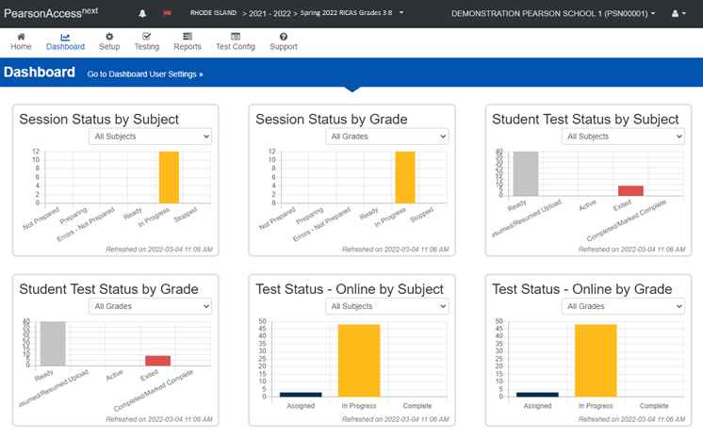
Dashboard Home Page
Here is a view of the Dashboard home screen.
Notes:
The Dashboard home page displays up to six different dashboards.

Slide 7
Dashboard Home Page
Dashboards can be viewed by subject or grade on the Dashboard home page as follows:
Session Status graph: Shows the number of PAN Sessions that are Not Prepared, Preparing, Errors – Not Prepared, Ready, In Progress, and Stopped.
Student Test Status graph: Shows the number of student tests that are Ready, Resumed/Resumed Upload, Active, Exited, and Complete/Marked Complete.
Test Status – Online graph: Shows the number of computer-based tests that are Assigned, in Progress, and Complete.

Slide 8
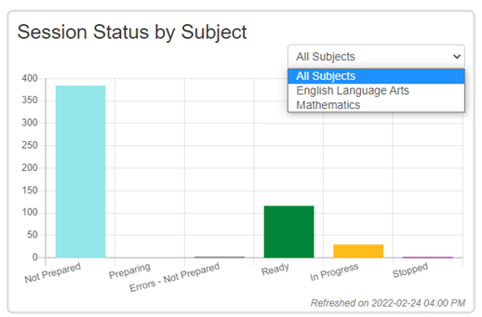
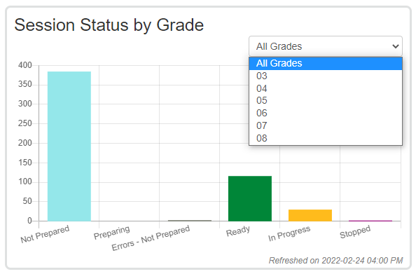
Dashboard Home Page – Session Status Dashboards
Session Status by Subject or Grade
Notes:
The Session Status dashboards show the number of PAN Sessions that are in each of the following statuses:
Not Prepared
Preparing
Errors – Not Prepared
Ready
In Progress
Stopped
Users can filter by subject or grade by selecting a subject or grade from the dropdown menus located on each dashboard. Test coordinators may want to use this graph to determine whether they have any Sessions that are not yet prepared on testing day, or if they have any Sessions that are not stopped at the end of testing. (All PAN Sessions must be stopped after testing has been completed.)

Slide 9
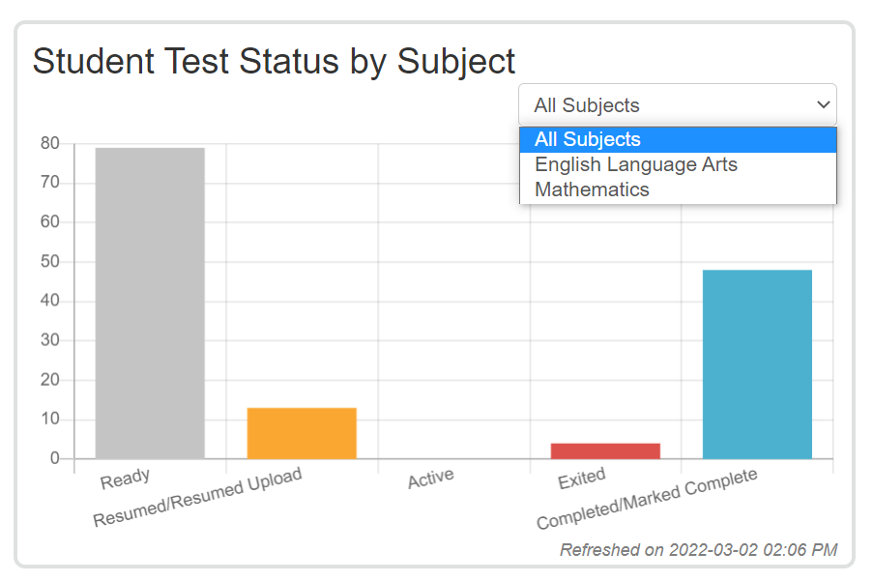
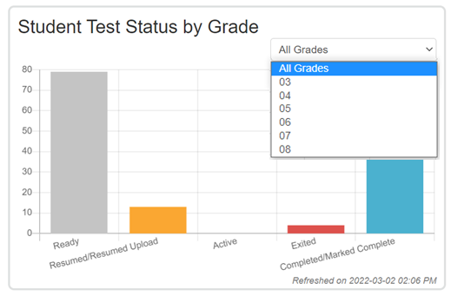
Dashboard Home Page – Student Test Status Dashboard
Student Test Status by Subject or Grade
Notes:
The Student Test Status dashboards show the number of student tests that are in each of the following statuses:
Ready
Resumed/Resumed Upload
Active
Exited
Completed/Marked Complete
Users can filter by subject or grade by selecting a subject or grade from the dropdown menus located on each dashboard. Test coordinators may want to use this dashboard to determine whether they have any student tests that are still in Active status at the end of a test session, or whether they have any student tests that are not in Complete or Marked Complete status at the end of testing.

Slide 10
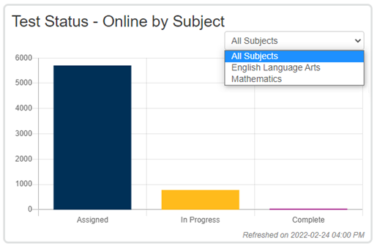
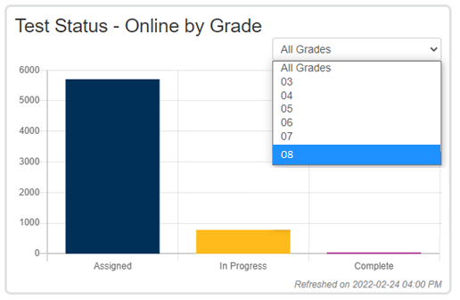
Dashboard Home Page – Test Status - Online
Test Status - Online by Subject or Grade
Notes:
The Test Status - Online dashboards show the number of computer-based tests in the following statuses:
Assigned
In Progress
Complete
Users can filter by subject or grade by selecting a subject or grade from the dropdown menus located on each dashboard. Test coordinators may want to use this dashboard to determine how many student tests in a subject or grade are not in Complete status.

Slide 11
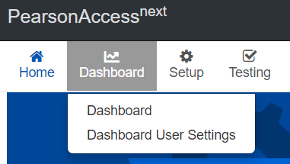
Dashboard User Settings
Users can adjust what they see on their Dashboard home page by changing the settings on the Dashboard User Settings page.
On the Dashboard User Settings page, users can:
Remove dashboards from their home page
Change the order in which the dashboards appear on their home page
Change the type of graph for each dashboard
Change the number of columns in which the dashboards appear
To access the Dashboard User Settings, select the Dashboard icon, and from the dropdown menu, select Dashboard User Settings.

Slide 12
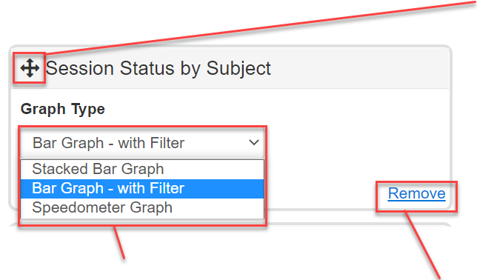
Dashboard User Settings
Change the order in which dashboards appear by holding down the crossed arrows of a particular dashboard, and moving the dashboard around the page.
Remove a dashboard from your home page by selecting “Remove.”
Change the type of graph that is shown by selecting a graph from the dropdown menu.

Slide 13
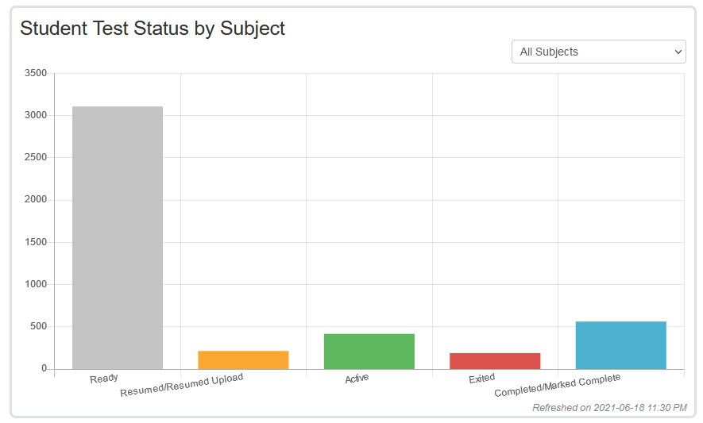
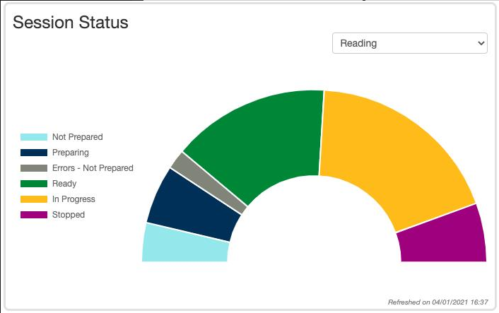
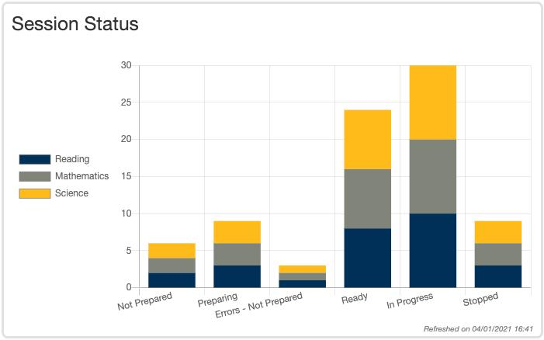
Dashboard User Settings
Bar graph with filter
Here are the three graph types that users can select from. Note that for the following dashboards, not all graph types are available:
Session Status by Grade
Student Test Status by Grade
Test Status – Online by Grade.
Speedometer
Stacked bar graph

Slide 14
Dashboard User Settings
Change the number of columns that appear on your Dashboard home page by selecting from the Number of Columns dropdown menu.

Slide 15
Dashboard User Settings - Columns
Example of the home page with one column:
Example of the home page with three columns:
Notes:
This slide shows examples of the home page view if a user selects a one column view vs. a three column view.

Slide 16
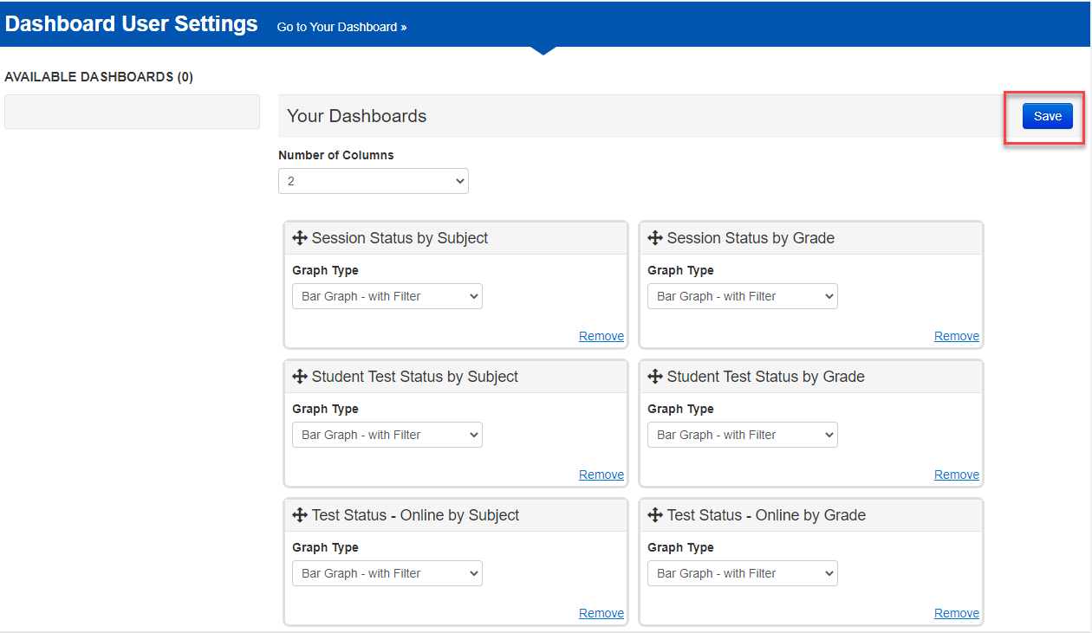
Dashboard User Settings
After making the desired changes to your dashboards, select Save.

Slide 17
Thank you!

