Slide 1
Accommodations and Accessibility Features for All Students, Students with Disabilities, and English Learners
Rhode Island Comprehensive Assessment Program (RICAS)
Notes:
This module presents an overview of the Accessibility and Accommodations policies for the RICAS tests for students in grades 3 through 8. Please review this information carefully, since there are important features that are available to all students.
We will also discuss accommodations that are available only to certain students, like students with disabilities or English learners. These policies are intended to help all students participate fairly and effectively in the RICAS tests.

Slide 2
Overview of RICAS Accessibility and Accommodations
Documents to use to support successful understanding and implementation of accommodations.
Documents can be found at www.ride.ri.gov/accommodations and http://ricas.pearsonsupport.com/
  Required: Accommodations and Accessibility Features Manual
  Required: Student Registration and Personal Needs Profile (SR/PNP) Guide
  Required: RICAS Assistive Technology Guide
  Required: Technology Skills for Students
  As needed for EL students: Bilingual dictionaries and glossaries list
  As needed for students with disabilities: Graphic organizers and supplemental reference sheets for English language arts and mathematics
Notes:
In addition to viewing this module, there are several documents to help you understand and prepare to administer RICAS accessibility features and accommodations.
All of the documents listed on this slide are available on the RIDE RICAS site or at the RICAS Pearson site.
The first four documents: Accommodations and Accessibility Features Manual, the SR/PNP guide, the Assistive Technology Guide, and the Technology Skills for Students should be read by everyone involved in testing and/or administering the RICAS assessments to students who use accommodations.
These last two documents provide information about certain accommodations: bilingual glossaries (via the list posted) for use by English learners, and certain resources (graphic organizers for ELA, supplemental reference sheets for math) for use by students with IEP/504 plans documenting those specific accommodations (see the Accommodations and Accessibility Features Manual).

Slide 3
Overview of RICAS Accessibility and Accommodations
Accommodations and test supports are in three groups:
  Universal Accessibility Features
    available to all students on computer- and paper-based tests
    either built into the computer-based system or provided by test administrator
  Designated Accessibility Features: can be given to any student at the discretion of the principal
  Special Access Accommodations are only available to students who meet that strict criteria, and include:
    For the RICAS ELA test:
      Human reader or text-to-speech options
      Human scribe or speech-to-text options
      Spell-checker options
      Word-prediction options
      Human signer for ELA reading passages
    For the RICAS math test:
      Calculator or mathematics tools on non-calculator section of the math test
Notes:
Many accessibility features are available to all students. Some of these are Universal Accessibility Features that are either built into the computer-based system or provided by a test administrator. Others are called Designated Accessibility Features which allow the principal to determine whether a student should have flexibility in their test setting, group size, or scheduling of the test. Some accommodations are available only to students with disabilities, while others are available only to English learners. Special Access Accommodations, previously called “nonstandard accommodations,” are available only to a small number of students with disabilities who meet certain guidelines to receive them. All of these will be described shortly.

Slide 4
Universal Accessibility Features for all students
Computer | Paper
Alternative background/font color (PNP) | Colored overlays
Screen magnification/zoom tool | Magnification device
Line reader tool | Tracking device/straight edge
Answer Eliminator | Use pencil to eliminate answer choices
Answer Masking (PNP) | Masking using blank card
Item flag/bookmark | Place marker
Alternate Cursor/pointer (PNP) | Enlarged pencil/writing instrument
Highlighter
Audio aids
Human read-aloud (or sign) selected words on Math, as requested by student
Test administrator repeats/clarifies test directions
Test administrator redirects student’s attention to test
Notes:
The Universal Accessibility Features shown on this screen are available to any student who needs them, depending on whether they are taking the computer- or paper-based test. There are two column headers on this table: Computer and Paper. On the left side, “Computer” is used to show the features that are available to students taking the computer-based tests using the TestNav platform. The “Paper” column on the right shows the equivalent accessibility feature for students taking the paper test.
Each of these universal accessibility features is described in the Accessibility and Accommodations policy manual. We will describe a few of them to you now.
“Answer Eliminator,” allows students to cross out answer options they think are incorrect on the computer-based test.
“Answer Masking” allows a student to read a line of text or an answer option while blocking out the rest of the question or the other answer options.
“Human read-aloud (or sign) selected words” allows a test administrator to read aloud or sign a selected word or phrase to any student on the Mathematics test, as requested by the student. For example, a student taking the Mathematics RICAS test is allowed to raise his or her hand and ask the test administrator to read aloud an unfamiliar word. The test administrator would then quietly read the word to the student without disturbing the other students taking the test. No definitions can be given; only the pronunciation is allowed.
Test administrators may also redirect the student’s attention back to the test, if he or she has lost their focus or is engaging in an unrelated activity.
Take a moment to review this list of Universal Accessibility Features and determine if you’d like to review any of these more closely in the Accessibility and Accommodations Manual.
Please also be aware that certain selected features and accommodations marked with the letters “PNP” mean that this must be documented in the student’s Personal Needs Profile (PNP), which we’ll discuss later in this module.

Slide 5
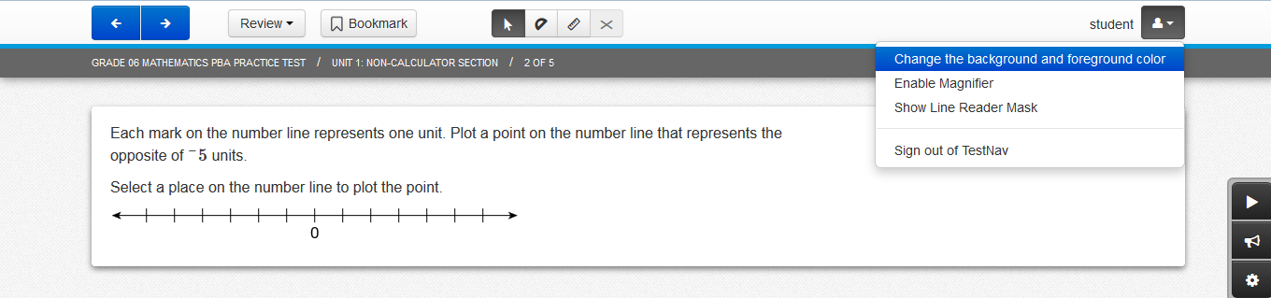
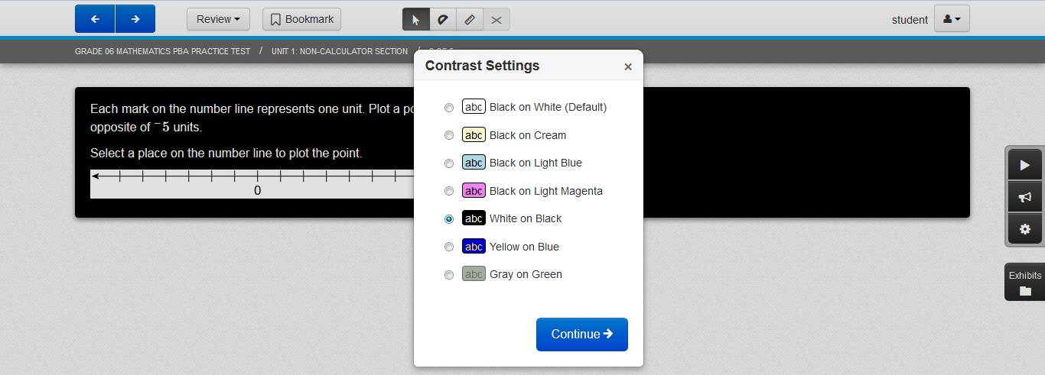
Alternative background/font color
Notes:
Here is an example of how the “Alternative background and font color” accessibility feature is used. This feature can benefit students with visual disabilities, but must be designated in the student’s Personal Needs Profile so the preferred color combination will be available to the student when they take the computer-based test. There are seven options for color settings that can be set in a student's SR/PNP. Only one will be available to the student in the operational test.

Slide 6
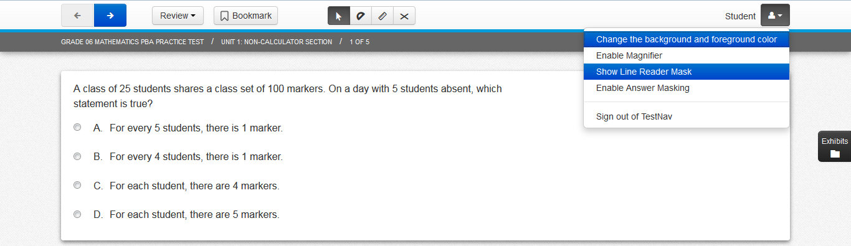
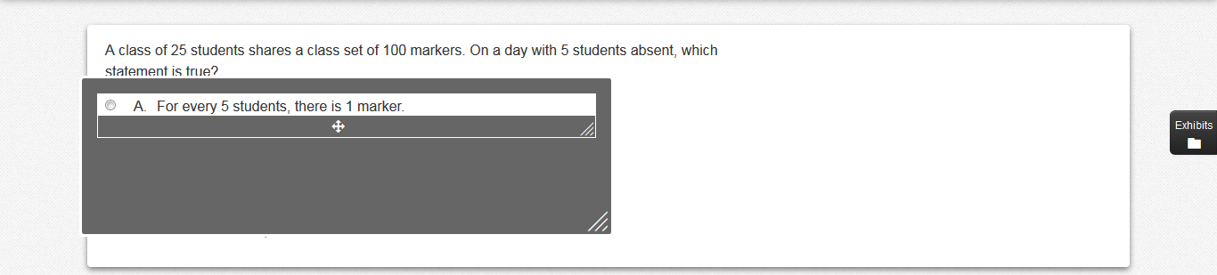
Line Reader
Notes:
The “Line Reader Tool” looks like this. It’s a gray box with a clear window that allows the student to focus on one line of text at a time and limit distractions from surrounding text.
A student may turn it on and off by selecting the icon shown on the screen.
The student can adjust the size of the box and the width and height of the reading line, and can move the line reader to different parts of the screen.

Slide 7
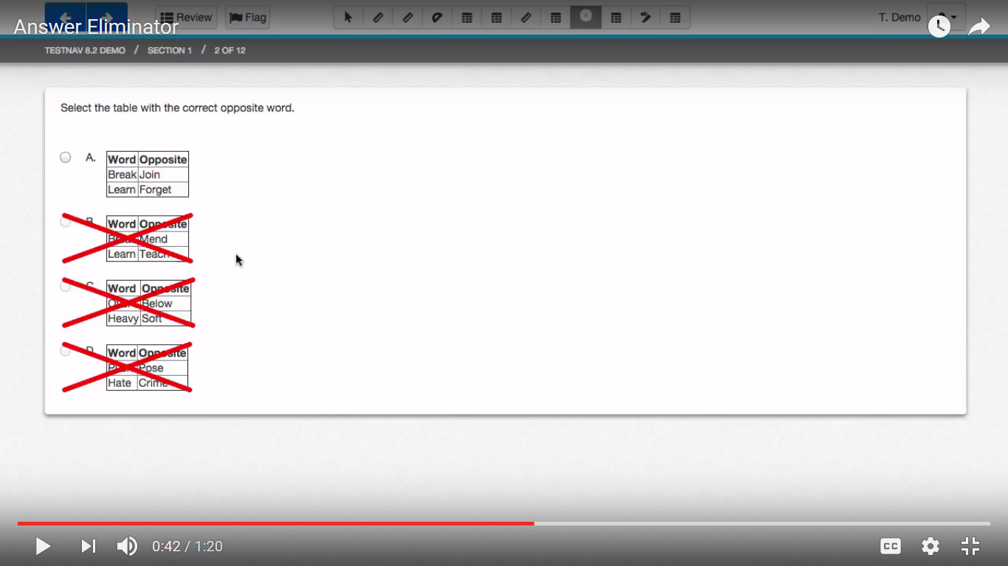
Answer Eliminator
Notes:
The Answer Eliminator looks like this. Students can use the icon on the screen to turn the answer eliminator on and off. Students can “X” out the answer options they believe are incorrect. This tool helps students keep track of which answers they thought were wrong and to narrow down the list of reasonable responses. Students taking the paper-based test can also use an “X” to cross out answer options in the test booklet that they believe are incorrect.

Slide 8
Designated Accessibility Features
Designated Accessibility Features: for any student, at principal’s discretion
Small group test administration (up to 10 students)
Individual (one-to-one) test administration
Frequent supervised breaks
Test in a separate location
Familiar test administrator
Seating in a specified area of room, including study carrel
Adaptive or specialized furniture or lighting
Noise buffer/noise-cancelling earmuffs/headphones (no music)
Student reads test aloud to self
Specific time of day
“Stop Testing” policy: If student is not responding to test questions after 15−20 minutes, test administrator may ask if the student is finished. If so, collect the student’s test materials. Student may sit quietly or be excused.
Notes:
Next, we’ll briefly review the list of Designated Accessibility Features.
These features are available to any student, if the principal or their designee gives their approval.
Many of these features determine where, with whom, and when students will be tested, as well as some other considerations.
Please note the state’s “Stop Testing Policy,” which may be especially helpful when testing first-year English learners and some special education students.

Slide 9
Presentation Accommodations for Students with Disabilities
Presentation Accommodations
Computer-Based | Paper-Based
Paper test, if unable to use computer (PNP) | N/A
N/A | Large print test (PNP)
Screen reader, only for student who is blind or visually impaired (PNP) | UEB Braille test (PNP)
Text-to-speech for Math or Human read-aloud for Math (PNP) | Human read-aloud for Math or STE (PNP)
Spanish for Math (PNP)
Human signer for Math or test questions only for ELA (PNP)
Test administrator helps student track test items
Notes:
The Accommodations listed here are available only to students with disabilities.
This slide describes some different ways in which the RICAS test can be presented to the student.
The left-hand column shows accommodations for students with disabilities who are taking the computer-based tests; the column on the right shows the equivalent accommodation on the paper-based test.
Accommodations that include the “PNP” designation must be listed in the student’s Personal Needs Profile (or PNP). Accommodations must be listed in the student’s IEP or 504 plan to ensure that he or she receives the accommodations to which they are entitled.
When RIDE registers students for RICAS, all students will be automatically registered for the computer-based tests. Students who are unable to take a computer-based test due to the effects of their disability may take a paper-based test instead, as an accommodation, if this is listed in their IEP or 504 plan.
The “text-to-speech” accommodation will allow a student to listen with headphones to a computer-based version of the test read aloud. The “human read-aloud” is the comparable accommodation for a student taking the paper-based test who needs the test read aloud. Be aware that reading aloud the ELA test is a “special access” accommodation that will be discussed later.
A “screen reader” is intended for use only by students who are blind or have visual impairments and already use a screen reader program such as JAWS or NVDA. The Braille test is an equivalent accommodation for students who are blind and cannot take the computer-based test.

Slide 10
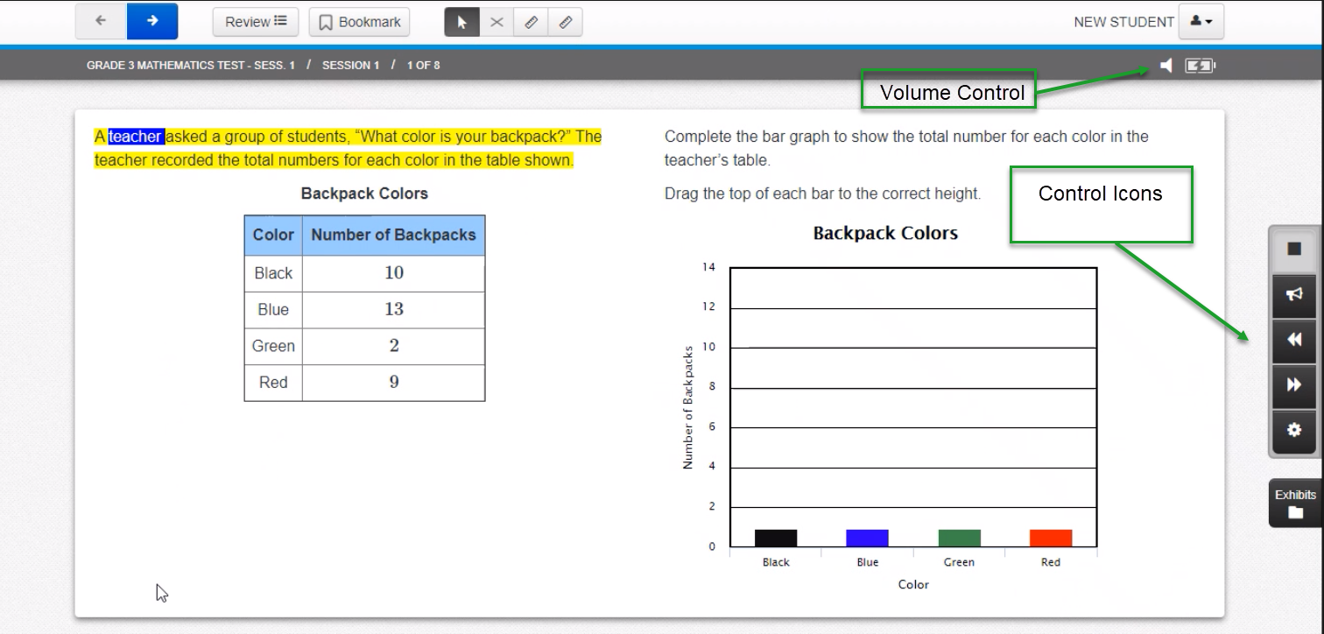
Text-to-Speech
Notes:
Here is what the text-to-speech feature looks like on the computer-based test. The sentence being read aloud is highlighted in yellow; the word being read aloud at the moment is highlighted in blue. The student can control the speed and the volume of the speaking voice using the control icons shown on the display.

Slide 11
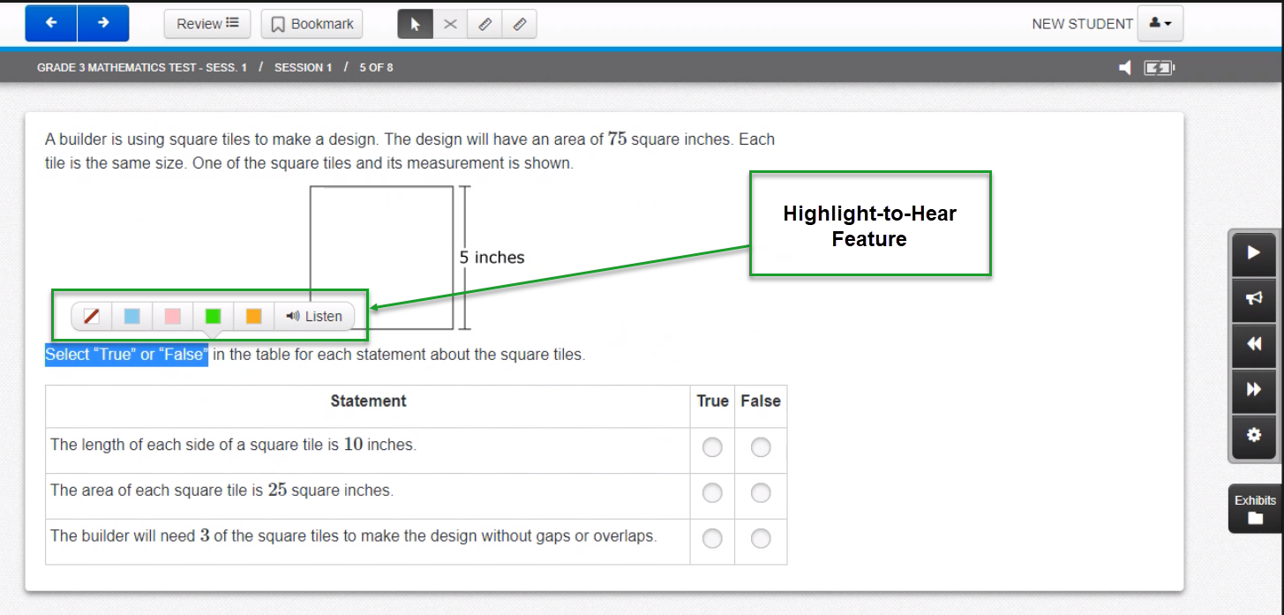
Text-to-Speech
Notes:
Additionally, students can highlight text for an option to “Listen” to the sentence the selection is tied to with the Highlight to Hear Feature.
With this feature, TTS will not continue reading past the end of this sentence.
It is important for students to become familiar with the look and feel of this accommodation before testing begins if they plan to use it on the test.
We strongly encourage students who need this accommodation to take practice tests using the text-to-speech accommodation so they will be familiar with how the text-to-speech accommodation works.

Slide 12
Response Accommodations for Students with Disabilities
Response Accommodations
Computer-Based | Paper-Based
Approved ELA graphic organizer or math reference sheet (only those developed by RIDE for math and ELA) (PNP)
Human scribe or external speech-to-text device for math (PNP)
N/A | Answers recorded in test booklet
N/A | Typed responses (PNP) (No transcription necessary)
Monitor placement of test responses
Responses recorded (audio or video), then transcribed by student during playback
Braille writer, note-taker, or refreshable Braille display
Notes:
Response Accommodations change the way in which a student with a disability responds to test questions. For example, typed responses are allowed on the paper-based test; or a scribe can write down the answers dictated by the student.
Another response accommodation is to allow a student with a disability to use an approved graphic organizer for the ELA test; or an approved supplemental mathematics reference sheet to answer questions on the mathematics test. Only the graphic organizers and reference sheets that have been approved by RIDE may be used, and only by a student with a disability who has this accommodation listed in their IEP or 504 plan. It is not permissible to add any text or graphics to these approved ELA graphic organizers or supplemental mathematics reference sheets, but schools are permitted to remove any graphics or text from the existing sheets. Students can use an ELA graphic organizer of their choosing as long as it does not contain any text. RIDE-approved graphic organizers and reference sheets have been designed especially to assist students in responding to questions on the RICAS tests. The use of this accommodation is collected in each student’s PNP.

Slide 13
Special Access Accommodations for Students with Disabilities
Computer and Paper
Text-to-speech/Human reader for ELA (PNP)
Signing the ELA reading passages (PNP)
Scribe responses (or speech-to-text device) for ELA (PNP)
Calculator or mathematics manipulatives on non-calculator session of math (PNP)
Spell-checker for ELA (PNP)
Word prediction for ELA (PNP)
Notes:
Special Access Accommodations, also known as “nonstandard accommodations” are used by a small number of students with disabilities on specific RICAS tests. They are called “special access” because they change part of what the test is designed to measure, and therefore should be used only by a very small number of students who meet certain guidelines. Eligibility to receive these accommodations is limited to students who are severely limited or prevented from performing the skill in question; such as a student who is virtually unable to calculate, write, read, or spell. Teams must carefully review the criteria described for each special access accommodation listed in the Accommodations and Accessibility Features Manual before designating these for students, and may consult with the RIDE staff beforehand.
All Special Access Accommodations must be included in the student’s Personal Needs Profile, or PNP.

Slide 14
Accommodations for English Learners (ELs)
EL Accommodations
Paper-based test in English OR Spanish (PNP) PBT in Spanish (math only) does not contain English translations of test items.
Approved Bilingual Word-to-Word Dictionary or Glossary
Text-to-speech/human reader for Math in English or Spanish (PNP) TTS in Spanish is not available on RICAS on CBT. If a student requires a read aloud in Spanish, a school or district staff person fluent in Spanish must read the Spanish math test to the student.
Scribe for Math (PNP)
Read aloud/repeat/clarify test directions in student’s native language, if native language speaker is available
Notes:
The accommodations listed in this table are intended for students who were reported as English learners in eRIDE. First-year ELs with low levels of English proficiency may take a paper-test, instead of a computer-based test, if they are unfamiliar with the use of technology. Several other accommodations are allowed for English learners, and the use of approved bilingual word-to-word dictionaries is also allowed for former ELs.
Please take a minute to review this list of accommodations available to ELs.

Slide 15
Special (Accommodated) Test Forms
The following test forms are available as accommodations and must be requested in the student’s Personal Needs Profile (PNP):
  Spanish Mathematics tests for EL students
  Text-to-Speech (digital read-aloud, requiring headphones)
  Screen reader (for a student who is blind or visually impaired; used in conjunction with a hard-copy Braille test)
  Web Extension form (Co:Writer or Read&Write) for the use of speech-to-text and/or word prediction assistive technologies.
  Compatible Assistive Technology (see Guidelines for Using Assistive Technology as a RICAS Test Accommodation)
  Large-print paper-based test
  Braille paper-based will be in UEB
Notes:
The special test forms listed on this slide are available as accommodations for students with disabilities. Please take a minute to review the list of accommodated forms.
For computer-based tests, text-to-speech, screen reader, and Assistive Technology forms are available.
For paper-based tests, large print and Braille forms are available. Please note that UEB tests will be available in both paper and refreshable Braille formats for all grade levels.

Slide 16
Assistive Technology (AT)
Guidelines for Using Assistive Technology as a RICAS Test Accommodation www.ride.ri.gov/accommodations and http://ricas.pearsonsupport.com
Students may use assistive technology (AT), when it is listed in their IEP or 504 plan; for example:
  Word prediction software
  Speech-to-text programs
  Adapted keyboard, mouse, screen enlargement
There are two categories of assistive technology:
  Compatible technology that interacts with TestNav.
  External technology that does not interact with TestNav
    Requires a second computer station not directly connected to TestNav
    May require test administrator to facilitate transfer of information from external station to computer used for assessment.
Internet access should be disabled or restricted during testing.
Notes:
Students with disabilities may use their familiar assistive technology to participate in the RICAS tests if the specific technology is listed in the student’s IEP or 504 plan. Assistive technology can include word prediction or speech-to-text programs; adaptive keyboards or mouse; and screen enlargement devices.
There are two kinds of assistive technology that can be used to take the test. One is an assistive technology program that is compatible with TestNav, the computer testing platform. Compatible programs are those that function within TestNav during the computer-based test. In this case, “Assistive Technology” must be requested in the PNP to ensure that the correct form of the test is provided to the student. A list of compatible assistive technology programs is listed on the “Guidelines for Using Assistive Technology as a RICAS Test Accommodation” available on the RIDE site at www.ride.ri.gov/RICAS (click on the Accommodations tab) or at ricas.pearsonsupport.com/tech-setup.
Other assistive technology programs may not be compatible with TestNav and are therefore considered external technology that does not interact with TestNav. These will require another nearby computer station that includes the assistive technology program or device that is not connected to the computer that uses TestNav. A test administrator may need to help the student transfer the information from the additional computer to the actual computer-based test. Schools should plan in advance for test administrations that will use assistive technology, and try these out beforehand using practice tests. It will also be important to make sure the student using assistive technology cannot access the Internet during testing.

Slide 17
Unique Accommodation Form
Accommodations and Accessibility Features Manual at www.ride.ri.gov/Accommodations
Notes:
Use the Unique Accommodation Form to request approval of an accommodation not listed in the Accessibility and Accommodations Manual. This form must be received by RIDE prior to testing. Please allow time for review and approval. Six weeks is recommended.
If you have questions, please contact Heather Heineke at heather.heineke@ride.ri.gov.

Slide 18
Test Preparation
Students should become familiar with features and basic functionality of TestNav.
  Technical Skills for Students document at www.ride.ri.gov/RICAS
View student tutorials at ricas.pearsonsupport.com/student/
Take online practice tests prior to test administration on TestNav.
Test coordinator should review IEPs, 504 plans, and any forms used to document accommodations for EL students
  Sample Documentation of Accommodations for an EL Student in Appendix A.
  Schedule testing for these students accordingly.
Notes:
Being comfortable and familiar with the online testing platform is important if students are going to do their best on the RICAS tests, particularly on the computer-based test. Educators should plan time to allow students to become familiar with the basic operation of the computer-based testing platform, called “TestNav.”
One way to prepare students is to view the Student Tutorial on the ricas.pearsonsupport.com web page. The Student Tutorial provides students with an interactive experience on how to use the various tools, screens, and commands in TestNav.
Another way to prepare students for the test is to have them take practice tests. The online practice tests will expose students to the types of test questions that will be asked on the RICAS tests.
Be sure that students’ accommodations are documented in their IEP and 504 plans, and that the test coordinator is aware of which students will receive which accommodations on the day of the test. Test results may be invalidated if students receive the incorrect accommodation, or if they do not receive the accommodations listed in their plan.
While it is not required, it is also important to document accommodations and any other test supports needed by English learners. You can use the sample “Documentation of RICAS Accommodations for an EL Student” found in the appendix of the Accessibility and Accommodations Manual.

Slide 19
Student Registration/ Personal Needs Profile (SR/PNP)
The function of the SR/PNP is to:
  assign students’ test method (i.e., computer, paper)
  provide information for initial shipment of special test forms (e.g., paper, large print, braille)
  assign form-based accommodations and/or accessibility features for computer-based testing prior to students taking the test
  collect information on selected accommodations
Guidance:
  Guide to the Student Registration/Personal Needs Profile (SR/PNP) at http://ricas.pearsonsupport.com/manuals/
  Student Registration/Personal Needs Profile module at http://ricas.pearsonsupport.com/training/
Notes:
An online student registration system is used to register students for the next-generation RICAS, including an accommodation tracking system called the Personal Needs Profile, or PNP. This system is used for indicating computer- or paper-based test method, for requesting accommodated test forms through the initial SR/PNP materials shipment, for assigning form-based accommodations and/or accessibility features for computer-based testing, and for reporting the use of certain selected accommodations.
More information on the process for reviewing and revising student information in the PNP is found in the Guide to the Student Registration/Personal Needs Profile (SR/PNP) on the RIDE website at www.ride.ri.gov/RICAS under the SR/PNP tab or at ricas.pearsonsupport.com/manuals/ under the “Test Admin Guidance” drop-down or the Student Registration/Personal Needs Profile training module found at ricas.pearsonsupport.com/training/.

Slide 20
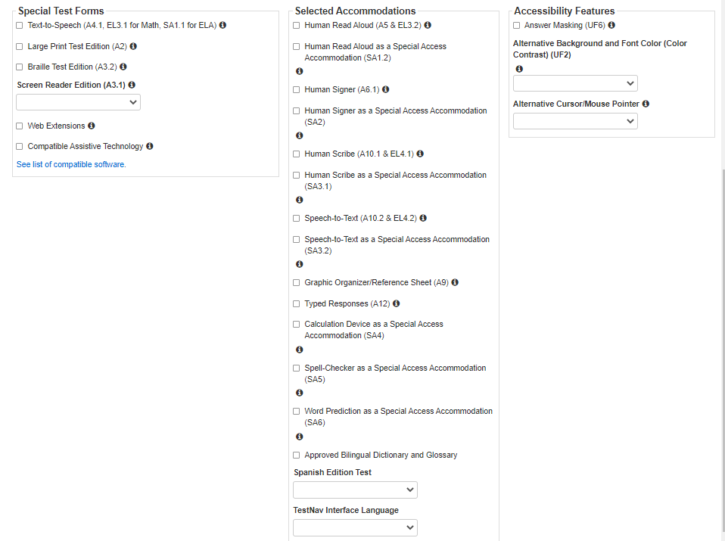
SR/PNP: Request Special Forms and Report Selected Accommodations
Notes:
Shown here is an example of the Manage Student Test screen which is part of the Student Registration/Personal Needs Profile, or SR/PNP. Schools can use the Manage Student Test screen to change or add an accommodation, indicate a special test form, or activate an accessibility feature for a student. The Manage Student Test screen may vary depending on the test. For example, the Calculation Device accommodation would only appear on the screen for the Mathematics test.
Check the list of features and accommodations carefully, and refer to the document entitled Guide to the Student Registration/Personal Needs Profile (SR/PNP) for information on how to access and complete the Manage Student Test screen.

Slide 21
Resources
Support and Assistance
  http://ricas.pearsonsupport.com/
Rhode Island Department of Education
  https://www.ride.ri.gov/accommodations
  https://www.ride.ri.gov/RICAS
Office of Curriculum, Assessment, and Instruction
  Heather Heineke
  Heather.Heineke@ride.ri.gov or assessment@ride.ri.gov
  401-222-8493
Notes:
Thank you for taking the time to view this module.
Please use the available resources at ricas.pearsonsupport.com and on the Rhode Island Department of Education’s website at www.ride.ri.gov/RICAS. You may also contact Heather Heineke for more information or with questions on accommodations for students with disabilities or English learners.

