Slide 1
Resolving Incorrect Accommodations During Testing
For Computer-Based Testing Only
Notes:
Welcome to the training module for resolving an incorrect accommodation when the student is actively testing. This training module describes the necessary steps to resolve an incorrect accommodation after a student has already begun testing.
This module is not applicable for paper-based testing.
This procedure applies only to the following accommodations that require a special accommodated CBT form:
Assistive Technology
Screen Reader
Text-to-Speech
Spanish Edition
Human Read Aloud or Human Signer (if a special PearsonAccess^{next} Session was not created)
For the Alternative Background and Font Color, Answer Masking, and Spell-Checker accommodations and accessibility features; a student can log out of TestNav and the PNP can be updated in the Manage Student Tests task by the test administrator. When the student logs back into TestNav, the accommodation or accessibility feature will be available.

Slide 2
Topics
Glossary
Overview
Mark Tests Complete
Resources
Notes:
We will cover the topics listed on this slide in this training module.
By the end of this module, you will understand the steps needed to assign students the correct accommodation after they started testing. If students have not started testing yet, instead refer to the SR/PNP module for the simple steps to update a student’s PNP.

Slide 3
Glossary
PearsonAccess^{next} (PAN): The online management system used to manage student tests, and manage activities for computer-based testing.
TestNav: The online testing platform that students use to take the computer-based RICAS assessments.
PAN Session: A group of students in PearsonAccess^{next} who will be testing at the same time. (This is different from the “test session.”)
Personal Needs Profile (PNP): A collection of selected accessibility features and accommodations a student will need to take an RICAS test.
Notes:
Please take a moment to pause the module so that you can read the definitions of the different components of the process to resolve an incorrect accommodation during testing. The pause button is located on the bottom, left-hand side of the screen.

Slide 4
Overview
If one of the following incorrect accommodations (human read-aloud or human signer, text to speech, screen reader, or assistive technology) is discovered after the student has started testing, the test administrator should ask the student to exit the test using the User Icon on the top, right-hand side of the TestNav screen.
The test coordinator should contact RIDE to report the irregularity and for RIDE to void that test (both sessions) and assign a new test to the student.
Once the test is marked void, the test coordinator must then update the student’s PNP accordingly with the correct accommodation or feature selected on the Manage Student Tests Screen.
The test coordinator will create a new PearsonAccess Next Session and place the student in it – ensuring (if applicable) the PAN Session’s test setting matches the student accommodation (e.g., human read aloud, human signer).
The test coordinator or test administrator will prepare and start the new PAN Session, and will print a new testing ticket for the student (and, if applicable, a new proctor testing ticket).
The student will log into the test using their new student testing ticket.
The test coordinator should follow instructions in the Test Coordinator’s Manual on submitting a detailed test irregularity report to RIDE. Please note that the student’s score may be invalidated for accountability purposes.
Notes:
If a student has begun testing and notified the test administrator that they do not have the correct accommodation (for example, a student began testing without Text-to-Speech), these steps will need to be followed:
If one of the following incorrect accommodations (human read-aloud or human signer, text to speech, screen reader, or assistive technology) is discovered after the student has started testing, the test administrator should ask the student to exit the test using the User Icon on the top, right-hand side of the TestNav screen.
The test coordinator should contact RIDE to report the irregularity and for RIDE to void that test (both sessions) and assign a new test to the student.
Once the test is marked void, the test coordinator must then update the student’s PNP accordingly with the correct accommodation or feature selected on the Manage Student Tests Screen.
The test coordinator will create a new PearsonAccessNext Session and place the student in it – ensuring (if applicable) that the PAN Session’s test setting matches the student’s accommodation (e.g., human read aloud, human signer).
The test coordinator or test administrator will prepare and start the PAN new Session, and will print a new testing ticket for the student (and, if applicable, a new proctor testing ticket).
The student will log into the test using their new student testing ticket.
The test coordinator should follow instructions in the Test Coordinator’s Manual on submitting a detailed test irregularity report to RIDE. Please note that the student’s score may be invalidated for accountability purposes.

Slide 5
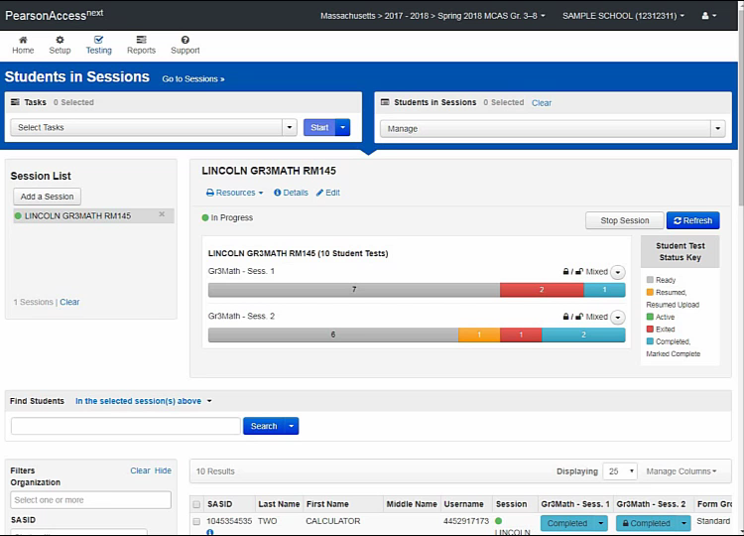
Mark Test Complete
Notes:
The test coordinator will need to mark the first test complete (that is, the one with the incorrect accommodation). To mark the test complete, locate the student in the Students in Sessions screen and check the box next to the student’s SASID. Go to Select Tasks and check Mark Student Tests Complete. Check the box next to the student’s name. Provide the reason (i.e.., student tested with incorrect accommodation), and then click Mark Complete. When finished, click Exit Tasks.

Slide 6
Resources
PearsonAccess^{next} User Guide: Mark Student Tests Complete
Notes:
The link on the screen provides detailed instructions on how to mark a student’s test complete.

Slide 7
Thank you.
Notes:
This concludes the Resolving Incorrect Accommodations During Testing training module. Thank you.

